Slide 1
INTERACTIVE NOTBOOK topic: STATISTICS class: teacher: Semester 2, Term 3

Slide 2
Contents
Glossary or Formula Page
Page
Date
Description
Word
Description
2
3

Slide 3
Tasks
24
7
30
Topic
Essential Question
Questions
Notes
Summary
8
9

Slide 4
24
7
30
Stem and leaf plots
Date
EQ – How do we create a stem and leaf plot?

Slide 5
From previous Lessons
The number of text messages that Isaac received each day for a week is shown:
47, 49, 54, 50, 48, 47, 55
What is the mean and median and range??

Slide 6
Activity – say it, show it, explain it
The numbers below represent the percentage that students received on their Science test.
Can you organise the information so that it is easier to understand.
56, 64, 68, 69, 55, 56, 69,
58, 55, 66, 49, 49, 63, 72,
75, 78, 55, 53, 42, 60, 85,
With a partner say what you did, show what you did, explain what you did.

Slide 7
What did you come up with?
Table?
Dot plot?
graph?
Frequency table?

Slide 8
24
7
30
Stem and leaf plots
Date
EQ – How do we create a stem and leaf plot?
What are Stem and
Leaf Plots?
A Stem and Leaf Plot is a plot where each data value is split into a "leaf" and a "stem“.
Example: 36
stem
leaf

Slide 9
24
7
30
Stem and leaf plots
Date
EQ – How do we create a stem and leaf plot?
What are Stem and
Leaf Plots?
A Stem and Leaf Plot is a plot where each data value is split into a "leaf" and a "stem“.
Example: 36 81
How do we put it together?
Example: 35, 42, 55, 49, 39, 40, 55, 33, 51
-fill in the rest
NOT DONE YET – PUT ‘leaves’ IN ORDER
stem
leaf
stem
leaf
stem
leaf
3 | 5
3 | 3 5 9
4 | 0 2 9
5 | 1 5 5
4 2

Slide 10
Your turn
The numbers below represent the percentage students received in their test.
Can you organise the information into a STEM-AND-LEAF plot
56, 64, 68, 69, 55, 56, 69,
58, 55, 66, 49, 49, 63, 72,
75, 78, 55, 53, 42, 60, 85,
FIND:
4 | 2 9 9
5 | 3 5 5 5 6 6 8
6 | 0 3 4 6 8 9 9
7 | 2 5 8
8 | 5

Slide 11
24
7
30
Stem and leaf plots
Date
EQ – How do we create a stem and leaf plot?
How can we gather data?
4 | 2 9 9
5 | 3 5 5 5 6 6 8
6 | 0 3 4 6 8 9 9
7 | 2 5 8
8 | 5
Lowest score =
Highest score =
Range =
Median =
Mode =

Slide 12
Brain Break
1, 2, 3 GAME
explain rules (2 people – say 1, 2, 3)
Stand up and find a partner
Add actions

Slide 13
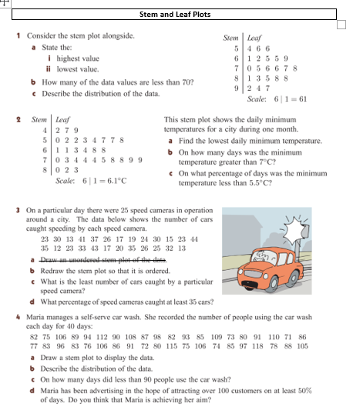
Task
Worksheet
STEM AND LEAF PLOTS

